Slide 1
Quiz
Creative computing society

Slide 2
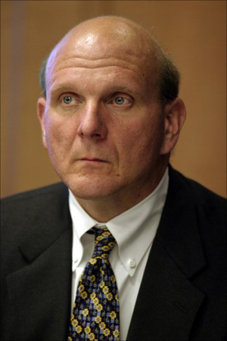
Identify the person?

Slide 3
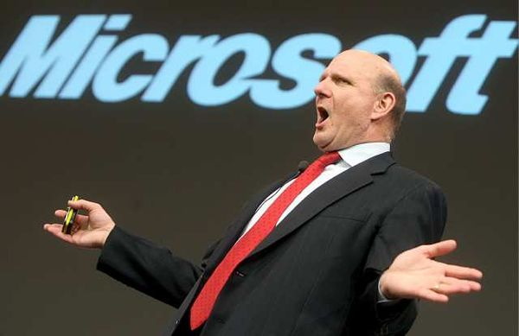
Steve baller
Steve ballmer is the CEO of microsoft, known for his energetic and exuberant persona, which is meant to motivate employees and partners. Recently he officially entered in a strategic alliance with nokia to launch windows based smart phones in the market.

Slide 4
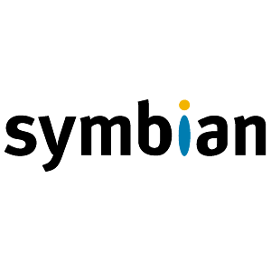
All your Nokia N series and E series smart phones are Symbian based. What exactly this Symbian is?

Slide 5
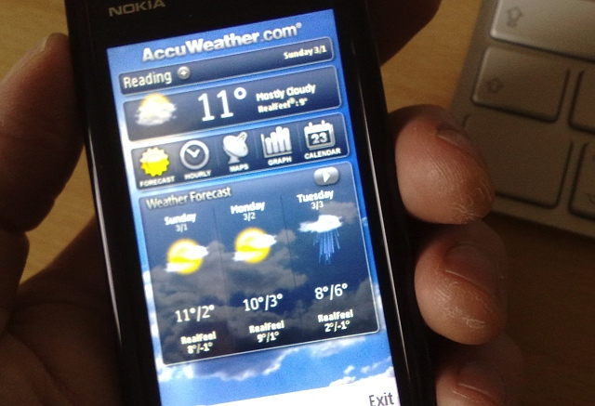
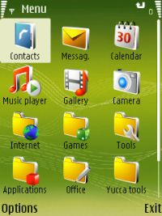
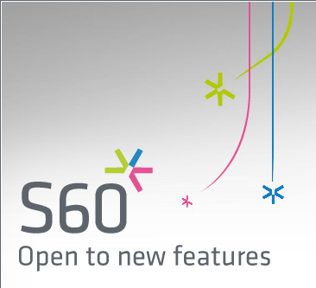
Operating system
Nokia launched the series S60 series of smartphones that include all your N series, E series and previously some 66xx series of smart phones. These have symbian installed as the operating system and the S60 platform which server as the GUI over the symbian OS. So you can have a variety of third party softwares running of these coll gadgets.

Slide 6
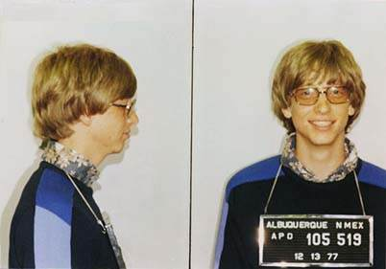
Who’s is this guy, being charged by the police?

Slide 7
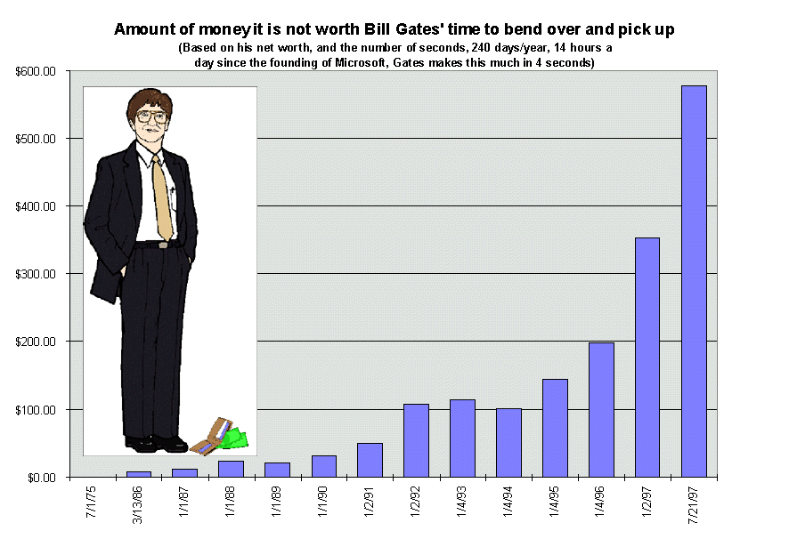
Bill Gates
Bill gates wrote his first program when he was 13, on a computer in his Lake Side school. Later on when he was at Haward, he was lured by Paul Allen to drop college and start Microsoft. Soon after Microsoft he became the richest man in the world and became the leader of the multi billion dollar software industry.

Slide 8
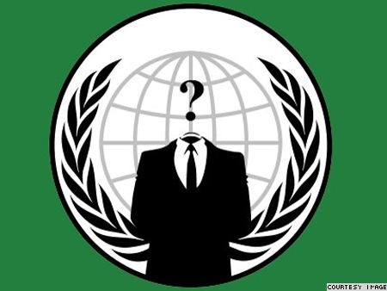
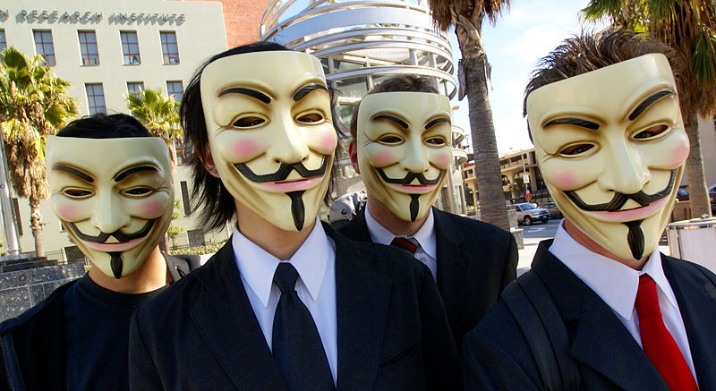
Anybody: Who are these guys? HINT - it’s a hacker group?

Slide 9
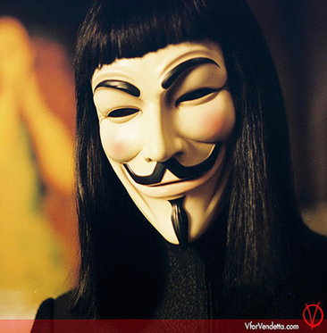
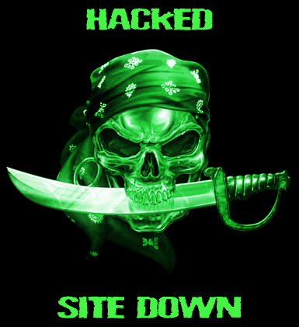
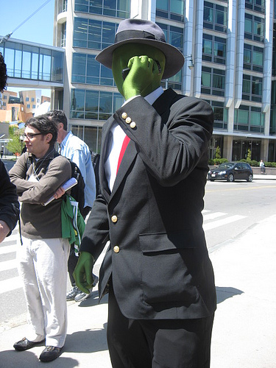
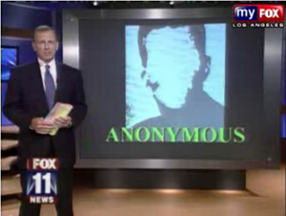
Anonymous
Anonymous is a hacker organisation with no leader, identity and people working does not know each other, hence working in a anonymous manner. Their goal is to spread internet freedom, freedom of speech and privacy.

Slide 10
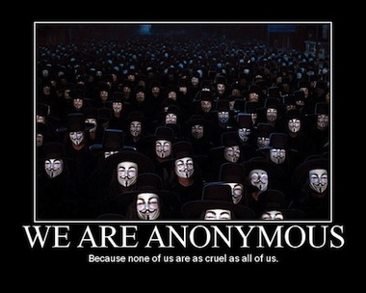
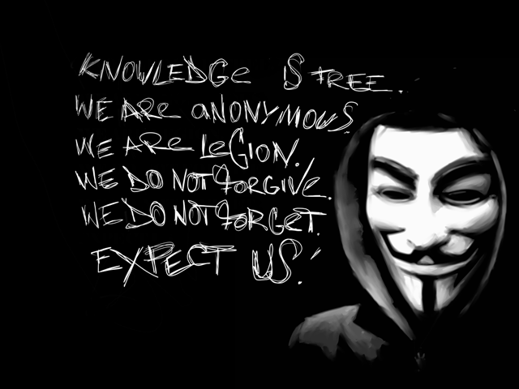
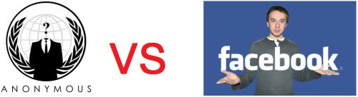
Anonymous
Anonymous hacked webistes of govt of malaysia, in response to govt blocking sites like wikileaks and pirate bay. They had a long internet conflict with sony and recently pledged to bring down facebook on Nov,5th 2011, on account that fb open its doors to govt and let its users private data breaching privacy laws of internet.

Slide 11


Slide 12
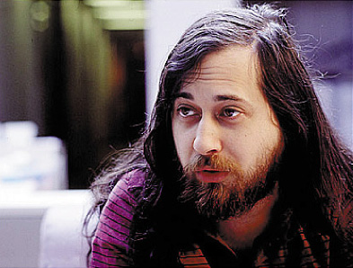
He is Richard Stallman. What he is known for?

Slide 13
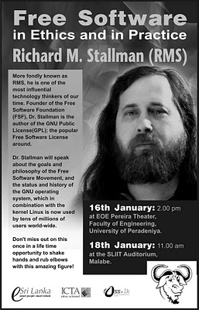
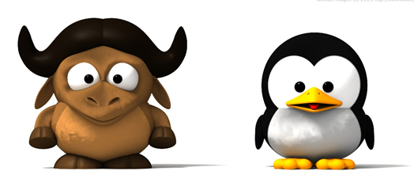
Free software GNU
GNU was created in response to software copyrights, started by bill gates. So many programmers started charging and shipping their software as binaries. Hacker group around MIT and most prominently Stallman considered it "a crime against humanity“ and in 1984 to develop the GNU operating system, a complete Unix-like operating system which is free software
“Free software” is a matter of liberty, not price. To understand the concept, you should think of “free” as in “free speech,” not as in “free beer.”

Slide 14

This is the logo of a new open source operating system for mobile devices. Which is it?

Slide 15
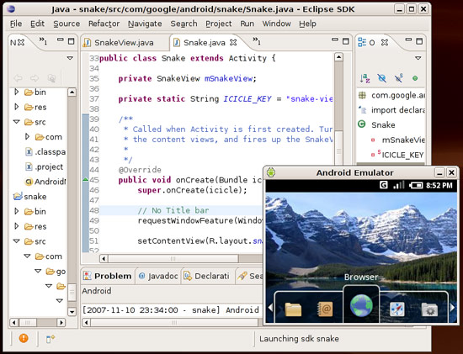
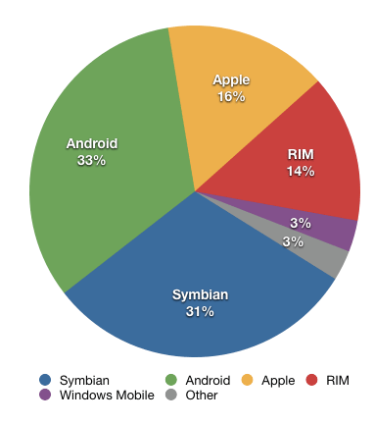
Android
Started by Google, Android is a software stack for mobile devices that includes an operating system, middleware and key applications. The main reason of its popularity is the fact that its open source so you can download and hack its code at your own will. For developing mobile Apps you can download android SDK and start coding!!!

Slide 16
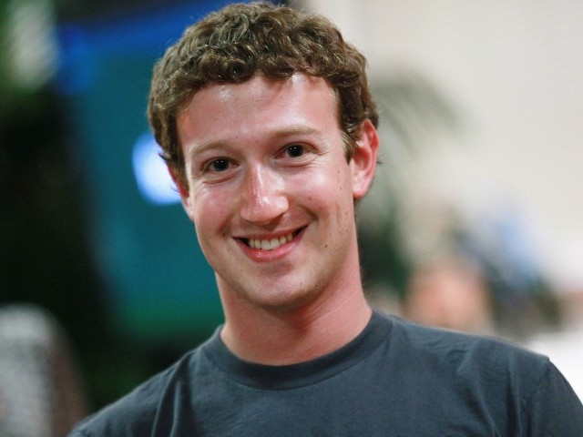
Who is he?

Slide 17
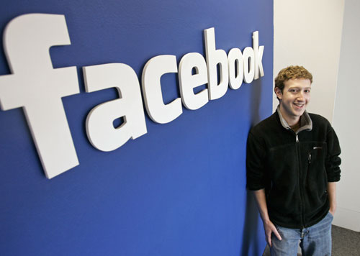
Mark zukerberg
Founded Facebook with his college friends, while he was student at Harvard University. Dropped out, following the footsteps Bill gates, Steve Jobs and many other computer giants and soon become a multidollar billionaire and proved the worth of business in web technologies.

Slide 18
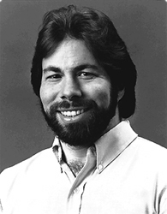
He is Steve wozniac, an electronics and software ‘hacker’, is the main architect of the products of one of the most influential computer and technology company. Which is that company?

Slide 19
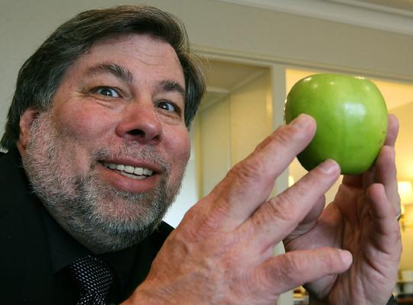
Apple
Steve wozniac was a true geek and very talented electronics and software hacker in home brew computer club. While Jobs is created with development of organisation, apple, he is the main technical developer of both ‘apple I’ and ‘apple II’ computer. This is contrary to popular notion that Jobs develops all apple products.

Slide 20
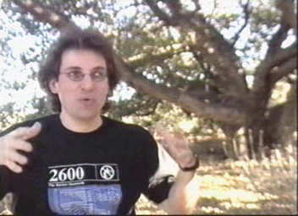
Anybody: Eminent hacker, security breacher, most wanted by FBI, hacked FBI and police machines to spy and monitor them and remained uncaught for more than 4 years. What’s his name?

Slide 21
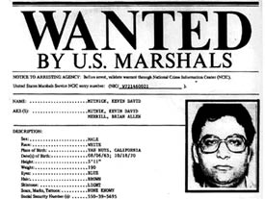
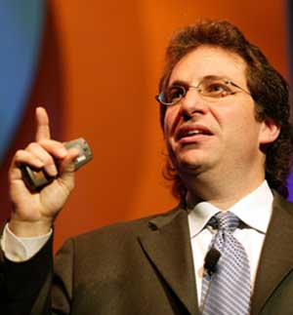
Kevin Mitnick
Kevin Mitnick was most wanted by FBI because he repeatedly hacked many government and phone websites. Later on he still lived in US, by hacking phone companies to fake his calls, issuing another identity to himself and monitoring FBI’s movement all by hacking their machines. He lived in another city for almost 4 years while on the most wanted list. Later after being caught, he served his sentence and now runs a security firm giving consultancy about security.

Slide 22
Identify the companies that use these taglines?
Think Different.
Where Do You Want to Go Today ; Your Potential Our Passion
Life's Good
Everything is Possible
What the web can be.
Everyone's Invited or Its hard to Imagine
Like. No. Other.
The Network is the Computer
Do More with Less

Slide 23
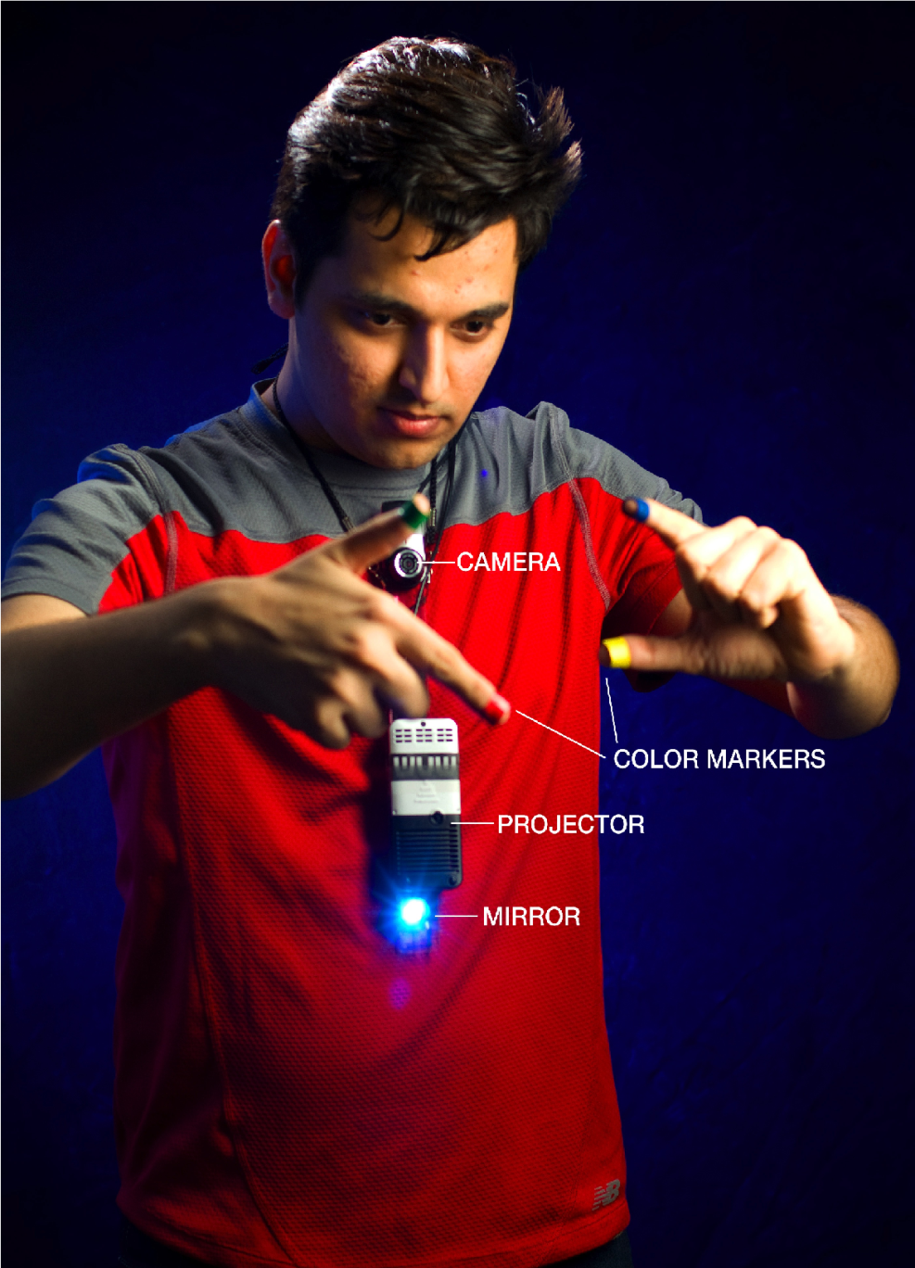
He’s an Indian, now works in MIT media labs, known for his sixth sense technology. Identify him?

Slide 24
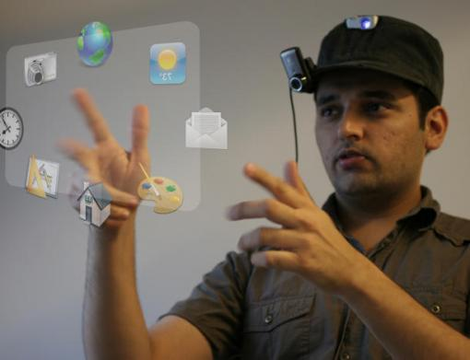

Pranav Mistry
Adsad

Slide 25

The company is popularly known as HP and is one of the prominent hardware manufacturer company. What is its full form?

Slide 26
Hewlett Packard
Adsad

Slide 27
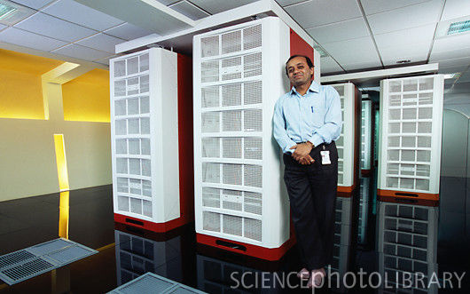
This is the first super computer of India, developed by C-DAC pune, India. What is its name?

Slide 28
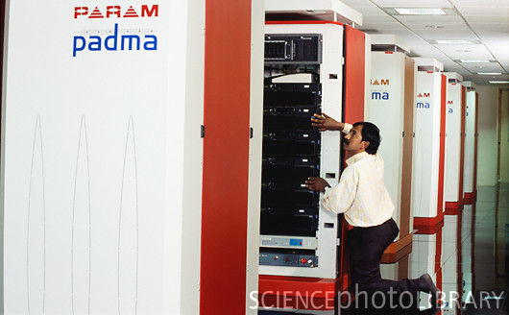
Param
The major applications of PARAM are in long-range weather forecasting, remote sensing, drug design and molecular modelling. PARAM is also used in many major scientific research institutes in India and may also see use in India's space programme.

Slide 29


Identify the logos?

Slide 30
Red hat linux Nvidia

